Slide 2
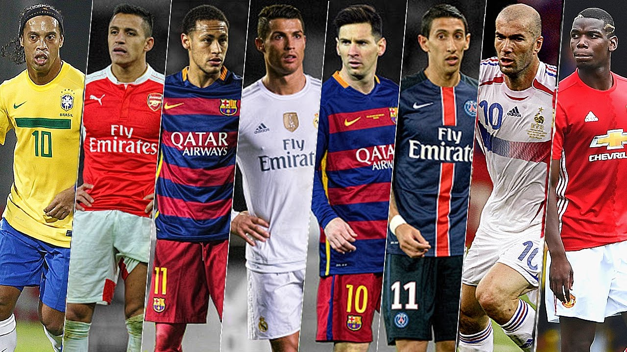
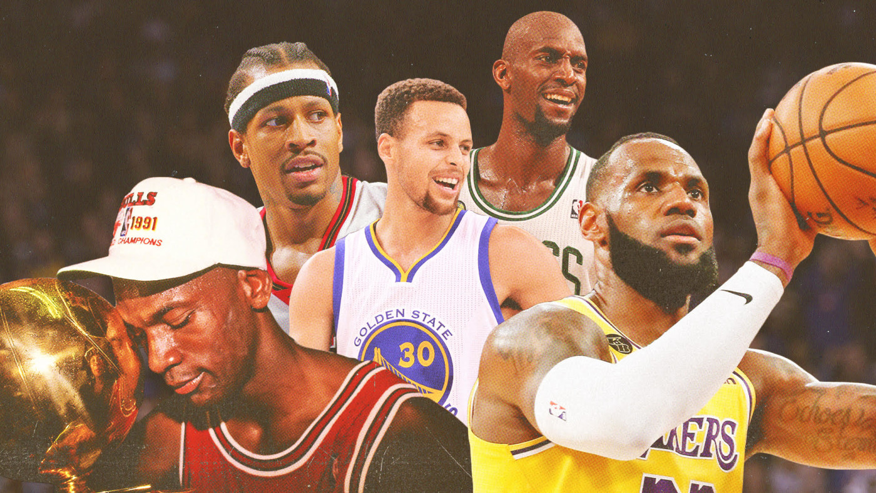
UNIT 6: CULTURE
FOOTBALL
VS
BASKETBALL

Slide 3
BINGO
1.Learned
2.Started
3.Went
4.Travelled
5.Won
6.Became
7.Watched
8.Did
9.Completed
10.Decided
11.Was/ were
12.Ran
13.Broke
14.Did
15.Saw
16.Swam
X
X
X

Slide 4
BINGO
1.Learned
2.Started
3.Went
4.Travelled
5.Won
6.Became
7.Watched
8.Did
9.Completed
10.Decided
11.Was/ were
12.Ran
13.Broke
14.Did
15.Saw
16.Swam
X
X
X

Slide 5
BINGO
1.Learned
2.Started
3.Went
4.Travelled
5.Won
6.Became
7.Watched
8.Did
9.Completed
10.Decided
11.Was/ were
12.Ran
13.Broke
14.Did
15.Saw
16.Swam
X
X
X

Slide 6
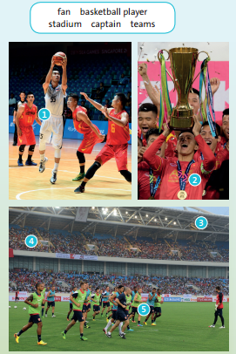
1/ Match the words in the box with 1-5:
fan, basketball player, stadium, captain, teams

Slide 7
1/ Match the words in the box with 1-5:
basketball player
captain
fan, , stadium, , teams
basketball player
captain

Slide 8
1/ Match the words in the box with 1-5:
fan,
stadium,
teams
stadium
fan
teams

Slide 9
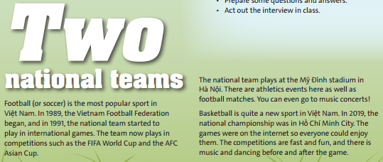

2/ Read and listen to the text. Then answer the questions:
1 When did the Vietnam Football Federation
begin?
2 What competitions does the team play in?
3 Where is the Mỹ Đình stadium?
4 Can you only watch football at Mỹ Đình?
5 Is basketball a new sport in Việt Nam?
6 How did lots of people watch the 2019
basketball competition?
7 What other things can you see at basketball
games?

Slide 10
2/ Read and listen to the text. Then answer the questions:
1/ When did the Vietnam Football Federation begin?
2/ What competitions does the team play in 1991?
3/ Where is the Mỹ Đình stadium?
In 1989, the Vietnam Football
Federation began.
In 1991, the national team started to play in international games.
Mỹ Đình stadium is in Hà Nội.

Slide 11
2/ Read and listen to the text. Then answer the questions:
4/ Can you only watch football at Mỹ Đình?
5/ Is basketball a new sport in Việt Nam?
6/ How did lots of people watch the 2019
basketball competition?
7 What other things can you see at basketball
games?
No, you can watch athletics events
and concerts.
Yes, it is.
On the Internet
Music and dancing

Slide 12
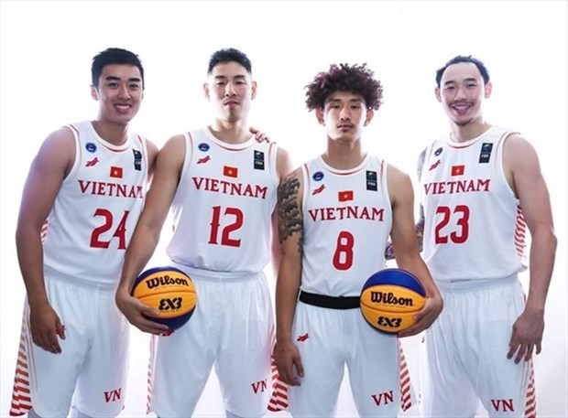
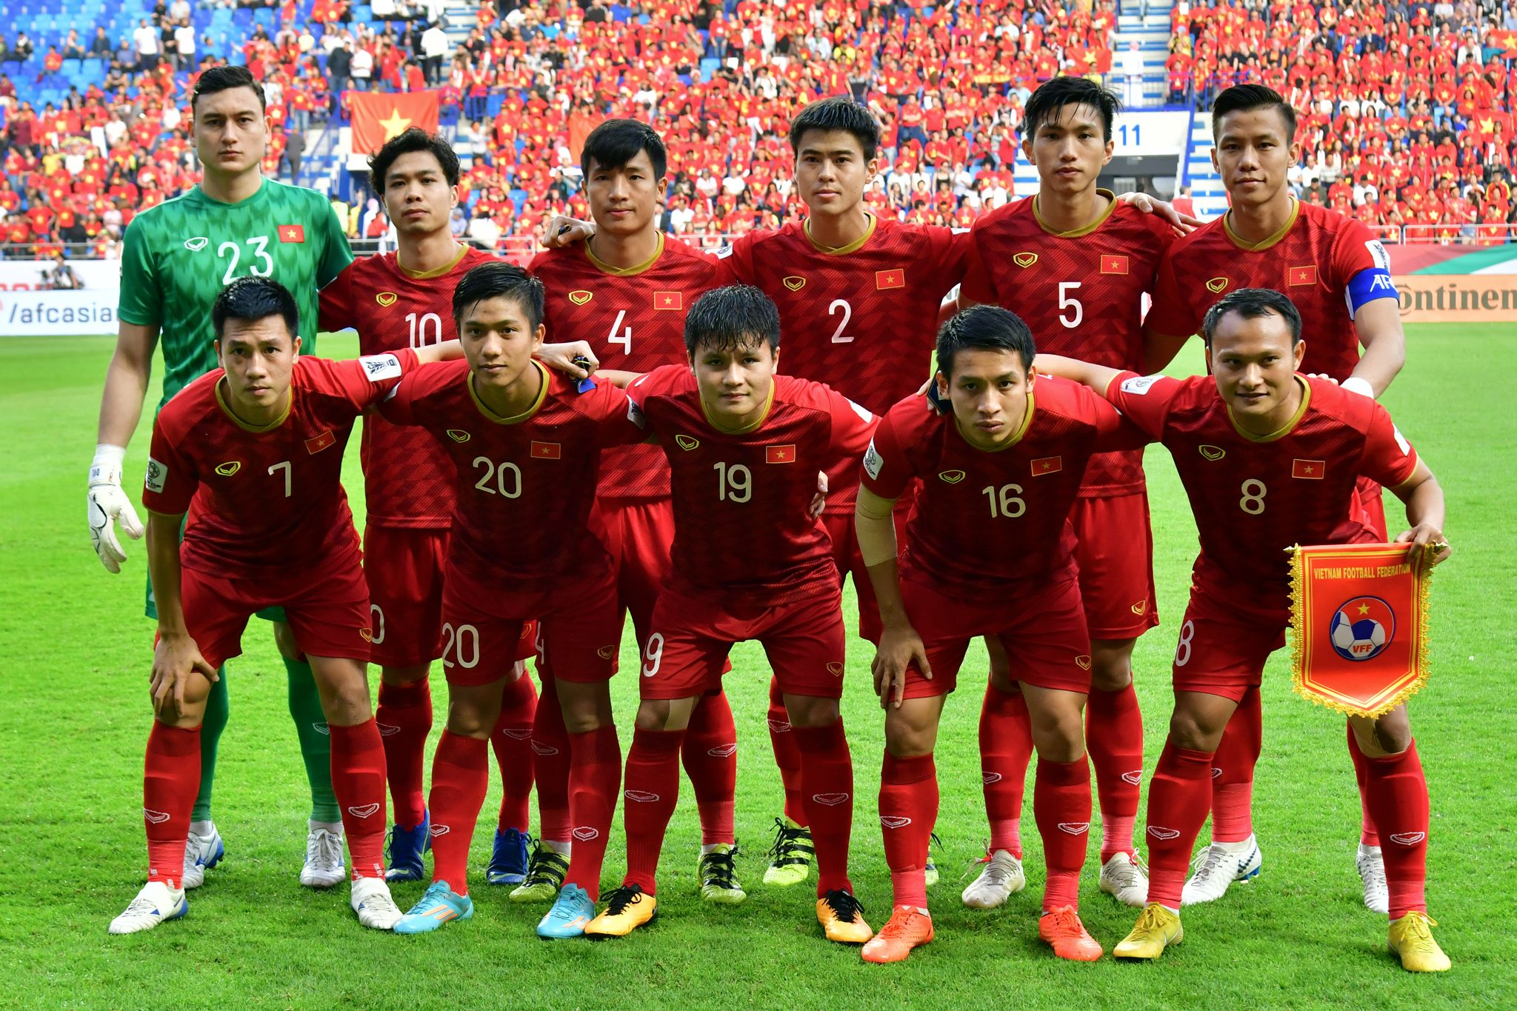
3/ YOUR CULTURE Answer the questions. Use the internet to help you find the information you need:
5/ What skills do you need to be good at football?
What skills do you need for basketball?
1/ Can you name three national football players or basketball players?
2/ Where and when is the next match for the national football team?
4/ Do you play basketball or football at school?
3/ Where does the national basketball team train?

Slide 13
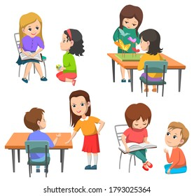
4/ USE IT! Prepare and practise an interview with a famous sports start. Follow the instructions:
Work in pairs. One of you is a famous sports star and the other is an interviewer.
Prepare some questions and answers.
Act out the interview in class.

Slide 14
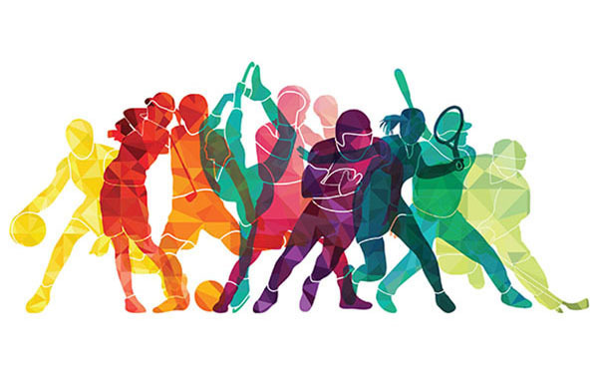
5/ SPEAKING IN GROUPS!
Which sports club do you like best?
What do you know about this sports club?

Slide 15

* HOMEWORK: - Learn by heart all the new words and irregular verbs. - Complete activity 3 if students can’t access the Internet in class. - Prepare activity 5 at home. - Prepare the next lesson “ Puzzles and games”.

Slide 16



www.phuongnam.edu.vn

Slide 17



Thank you!
CTCP ĐẦU TƯ VÀ PHÁT TRIỂN GIÁO DỤC PHƯƠNG NAM

